Slide 1


A STORY OF ULTIMATE MEDIA OPTIMIZATION
OMNI-CHANNEL ATTRIBUTION

Slide 2

MIKHAIL Stepnov
Head of Advanced Analytics

Slide 3
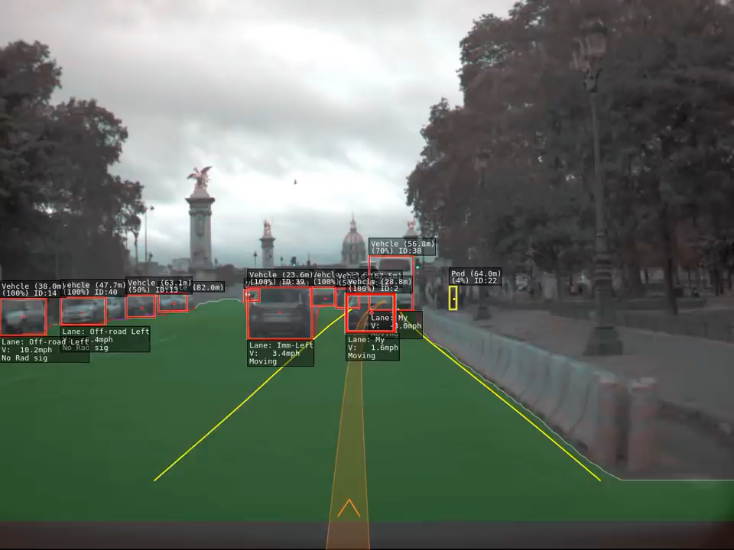

Slide 4

DATA = BETTER DECISIONS

Slide 5

AnD WHAT ABOUT MARKETING?

Slide 6
BUSINESS OWNS AND COLLECTS A LOT OF DATA
SALES
SITE/STORE TRAFFIC
LEADS, APP DOWNLOADS

Slide 7
BUSINESS OWNS AND COLLECT A LOT OF DATA
SALES
SITE/STORE TRAFFIC
LEADS, APP DOWNLOADS
BRAND HEALTH TRACKING
SOCIAL BUZZ
SEARCH REQUESTS

Slide 8
BUSINESS OWNS AND COLLECT A LOT OF DATA
SALES
SITE/STORE TRAFFIC
LEADS, APP DOWNLOADS
BRAND HEALTH TRACKING
SOCIAL BUZZ
SEARCH REQUESTS
MEDIA BUDGETS
RATINGS, IMPRESSIONS, TRAFFIC

Slide 9
BUSINESS OWNS AND COLLECT A LOT OF DATA
SALES
SITE/STORE TRAFFIC
LEADS, APP DOWNLOADS
BRAND HEALTH TRACKING
SOCIAL BUZZ
SEARCH REQUESTS
MEDIA BUDGETS
RATINGS, IMPRESSIONS, TRAFFIC
MARKETING ACTIVITES
PROMOS
COMPETITORS

Slide 10
BUSINESS OWNS AND COLLECT A LOT OF DATA
SALES
SITE/STORE TRAFFIC
LEADS, APP DOWNLOADS
BRAND HEALTH TRACKING
SOCIAL BUZZ
SEARCH REQUESTS
MEDIA BUDGETS
RATINGS, IMPRESSIONS, TRAFFIC
MARKETING ACTIVITES
PROMOS
COMPETITORS
WEATHER
INFLATION
OTHER MACROPARAMETERS
AND MUCH MORE…

Slide 11

WHAT’S BUSINESS DESIRE?

Slide 12
WHAT DRIVES GROWTH?

Slide 13
HOW MUCH GROWTH?

Slide 14
HOW MUCH TO SPEND?

Slide 15
NOW!

Slide 16
AND TOMORROW!

Slide 17
CAN YOU DO IT?!

Slide 18

UGH, NO…

Slide 19
UGH, NO…
BUT…

Slide 20

WE KNOW WHAT TO START FROM

Slide 21
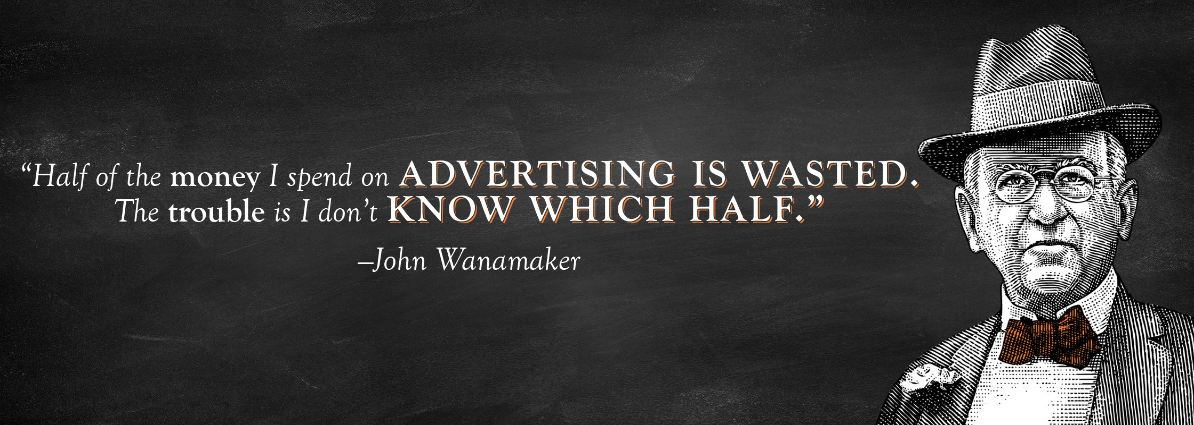

Slide 22
BUT MR. WANAMAKER DIDN’T KNOW ABOUT PUBLICIS OMNI-CHANNEL ATTRIBUTION

Slide 23


Slide 24
What is Omni-Channel Attribution?
OCA is an approach that utilizes live, persona-based data to generate insights about most efficient ways to maximize business KPIs
Advanced Marketing Mix Modelling
Live updates
Media planning tool
dashboards
Multi-Touch Attribution
Omni-Channel
Attribution
+
+
=

Slide 25

MARKETING MIX MODELLING VS. OMNI-CHANNEL ATTRIBUTION
MARKETING MIX MODELLING
OMNI-CHANNEL ATTRIBUTION
STATIC
ON-GOING
AGGREGATED
DETAILED (CUSTOMERS SEGMENTS, PRODUCTS)
ANALYSIS OF HISTORY
LEARNS FROM PRESENT
DATA IS SEPARATED
DATA IS INTEGRATED
SINGLE BRAND
MULTIPLE BRANDS, CATEGORIES, PRODUCTS
PPT AND EXCEL
WEB-APP
STILL WANT MMM?

Slide 26
GENERAL PROJECT FLOW
Media consumption
and interests, other persona-based data
Any other available data (macroeconomics,
news, etc.)
Data enrichment area. As much secondary data about consumers as possible to be put into system.
Brand Health and
other research data
MODERN
PORTFOLIO
Live Dashboard output
with statistics, forecast,
scenario analysis and
Media campaign controls
DATA FUSION AND
ENRICHMENT
MODELLING
ECOSYSTEM
Media
campaign
management
data
Persona-
based data

Slide 27

PERSONA-BASED DATA AND DATA ENRICHMENT
Company’s product usage of particular client/consumer
Product 1 | Product 2 | … | Product N

Slide 28
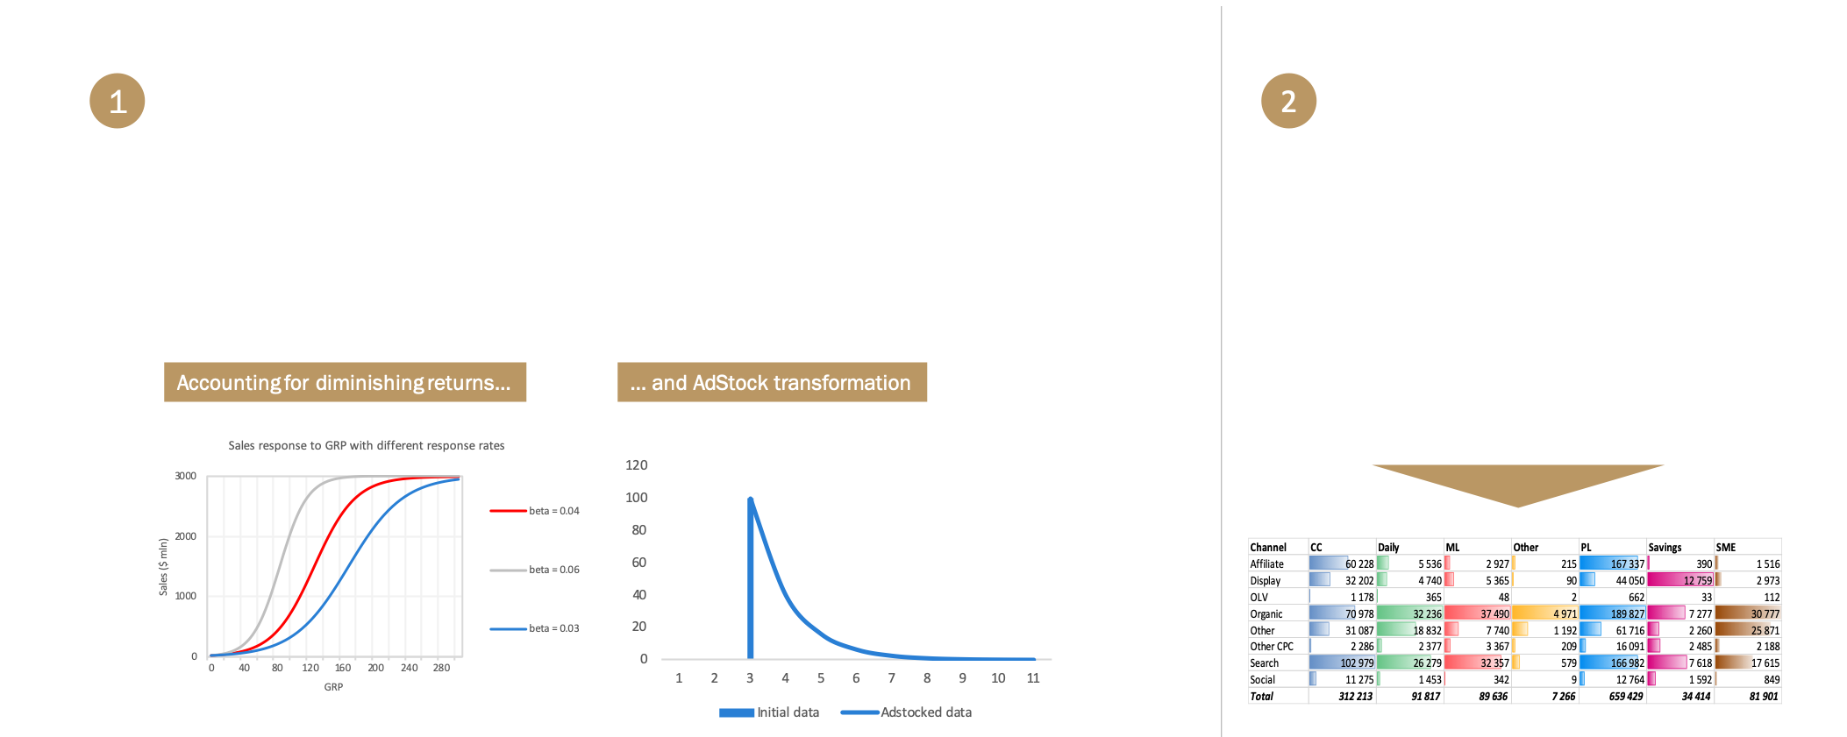
THEORETICAL BACKGROUND OF APPROACH

Slide 29
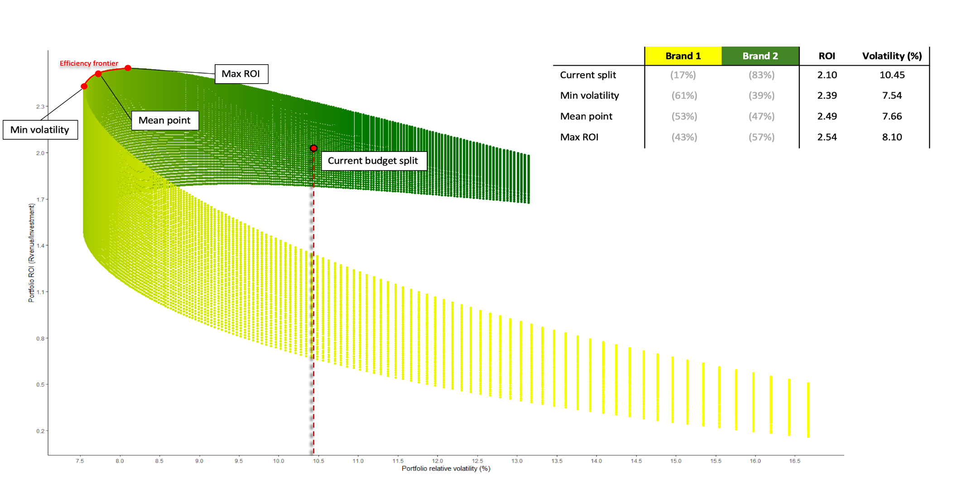
MODERN PORTFOLIO APPROACH FOR MEDIA
Create portfolio analysis tool to identify budget split across brands which is optimal for the client in terms of average expected profit and volatility of the outcome

Slide 30
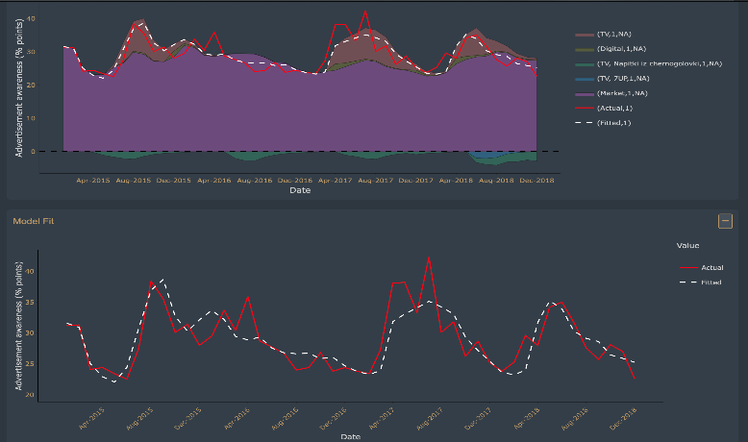
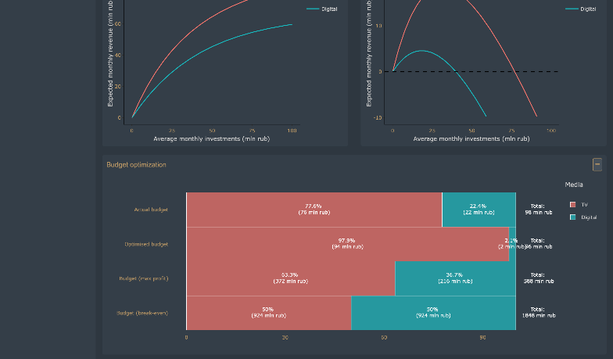
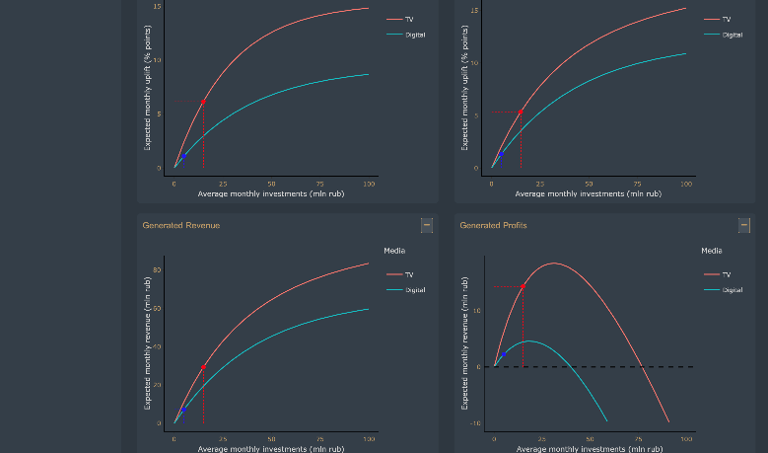
LIVE DASHBOARD: CONTROL AND MEASURE
Ability to get deep insights
for each brand in the portfolio
Visualization of historical budget decomposition across brands and channels
Visualization of optimal budget decomposition across brands and channels
Optimization tool simulating outcomes for different budget splits across brands and channels

Slide 31
KEY OCA OUTPUTS
MEDIA & OTHER FACTORS’ DECOMPOSITION (WITH HALO-EFFECTS)
ROI BY MEDIA CHANNELS
MEDIA BUDGET & PLANNING RECOS: MEDIA MIX, BANK PRODUCTS PRIORITIZATION
KPI FORECAST WITH DIFFERENT SCENARIOS
ONGOING OPTIMIZATION AND PLAN-FACT ANALYSIS

Slide 32

CASE STUDY:
RAIFFEISEN BANK

Slide 33
In short words
6
months of hard work
100
models in modelling ecosystem
over
7
days between model updates
100
parameters
was tested in the model
over
Integration with Bank Data Lake and BI system

Slide 34
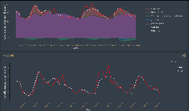
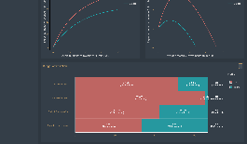
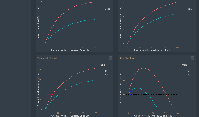
This year Raiffeisenbank headed to even better media optimization to attract more new clients
Key objectives in terms of OCA project:
To understand at what investments level
media channels exhibit saturation
To calculate optimal media budget size for
given business KPIs and restrictions
To learn how to optimally allocate budget
between bank’s products
To set up an infrastructure
to easily use dashboards and planning tools
Personal loans
Credit cards

Slide 35
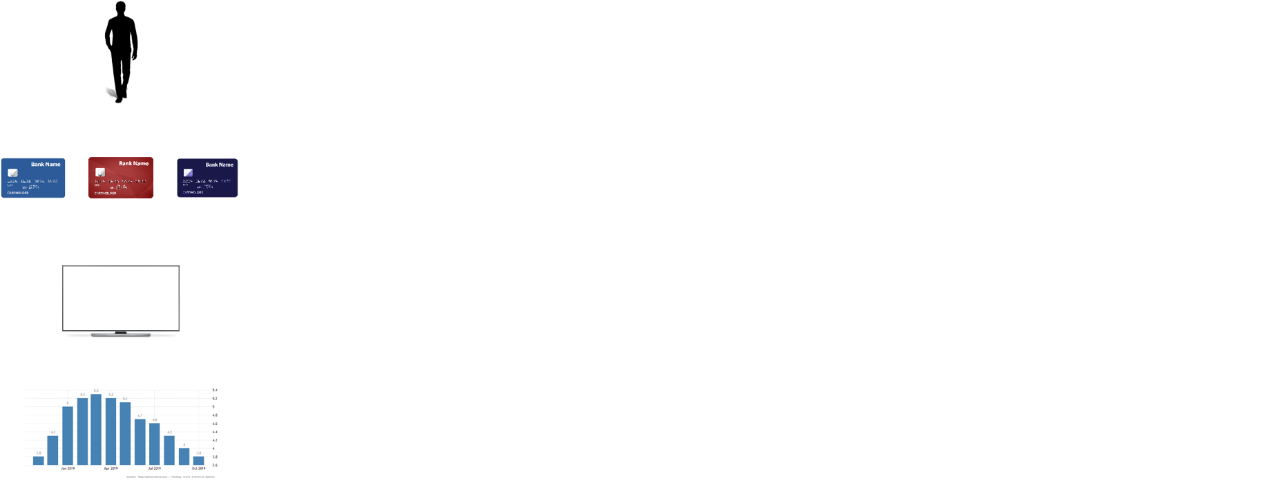
To fulfill the needs we have collected following DATA

Slide 36
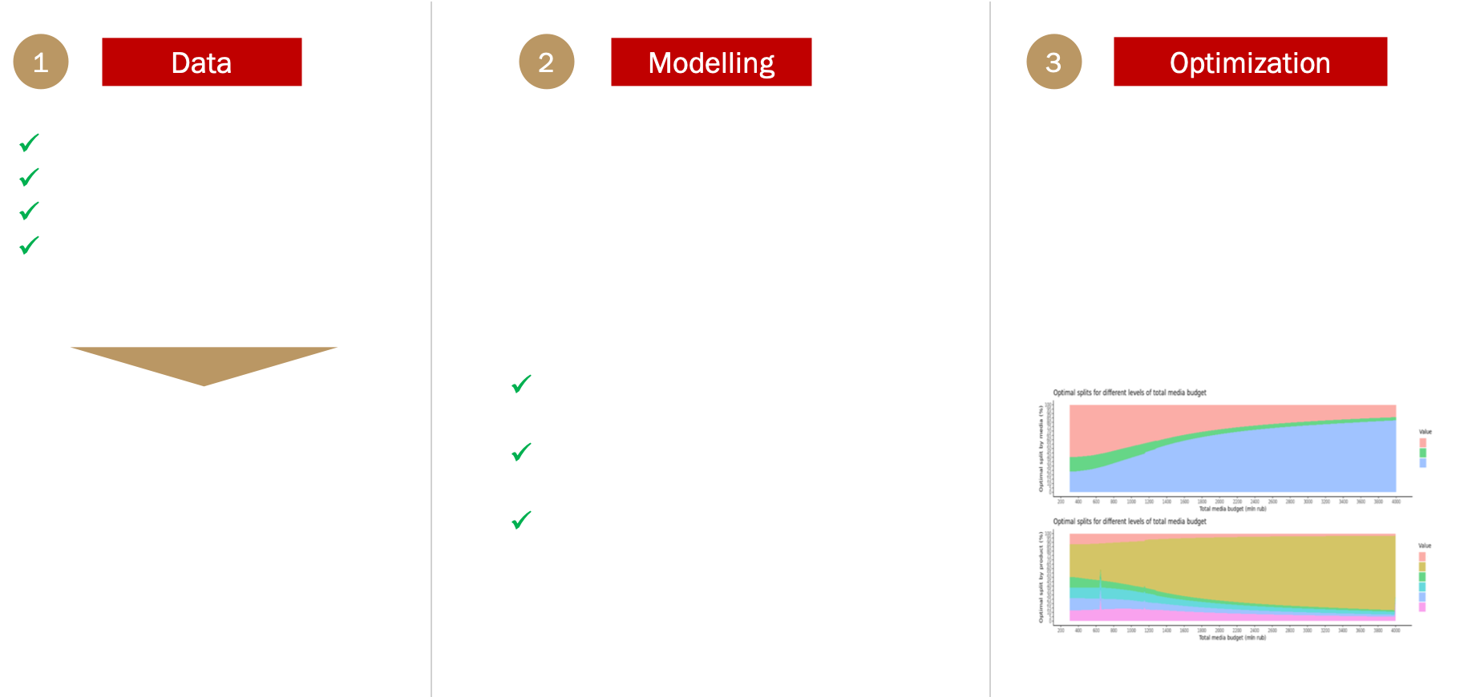
Modelling approach: from data to optimization

Slide 37
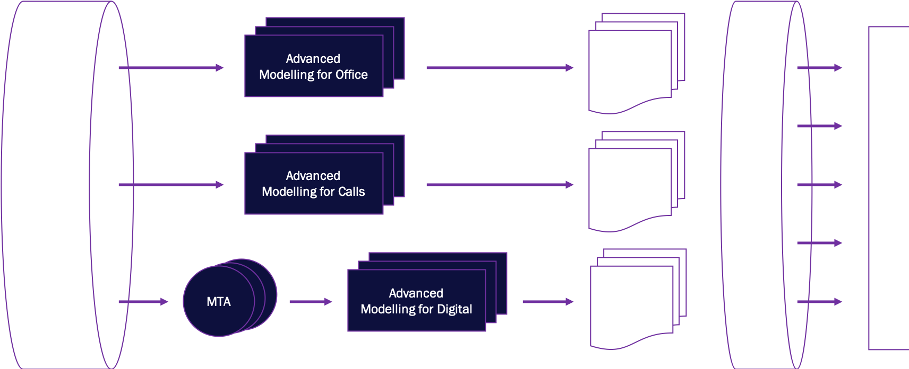
Principal modelling ecosystem scheme

Slide 38
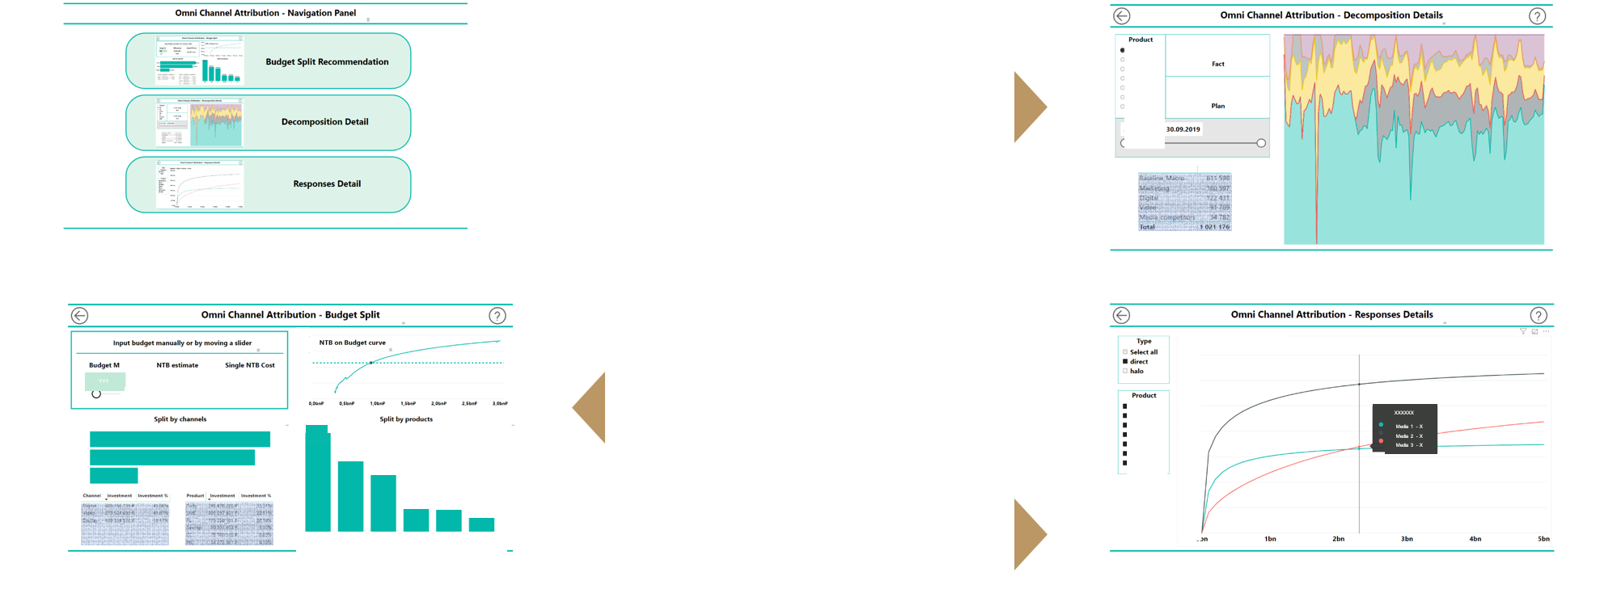
Outputs and visualization

Slide 39

WHO can BENEFIT FROM OCA?

Slide 40
BANKS
TELECOM
AUTOMOTIVE
RETAIL
FMCG
PHARMA
FAST-FOOD
IT
YOU

